Slide 1



广东君通达信息科技有限公司

Slide 2


我们不懈努力，致力成为
最专业的办公用纸综合服务提供商
成立于2003年/23年的市场历练/在广东省建立了广泛深入的市场渠道/完善的服务体系/一切只为快速布局与销售

Slide 3

广东君通达
广州市现代办公设备行业商会会长单位
广州工业经济联合会/广州市企业联合会
广州市企业家协会副会长单位
在广东省拥有超过1000家合作代理商及落地服务商
在多个市场拥有自己的分支机构及参股企业
能高效实现产品的快速布局
更能提供完善的售后服务

Slide 4



我们23年在广东省渠道上的深耕细作，一直是我们坚持的发展方向，我们恪守经营的理念与价值观，珍惜口碑，从而使我们成为众多客户、渠道商长期信任的合作伙伴！

Slide 5

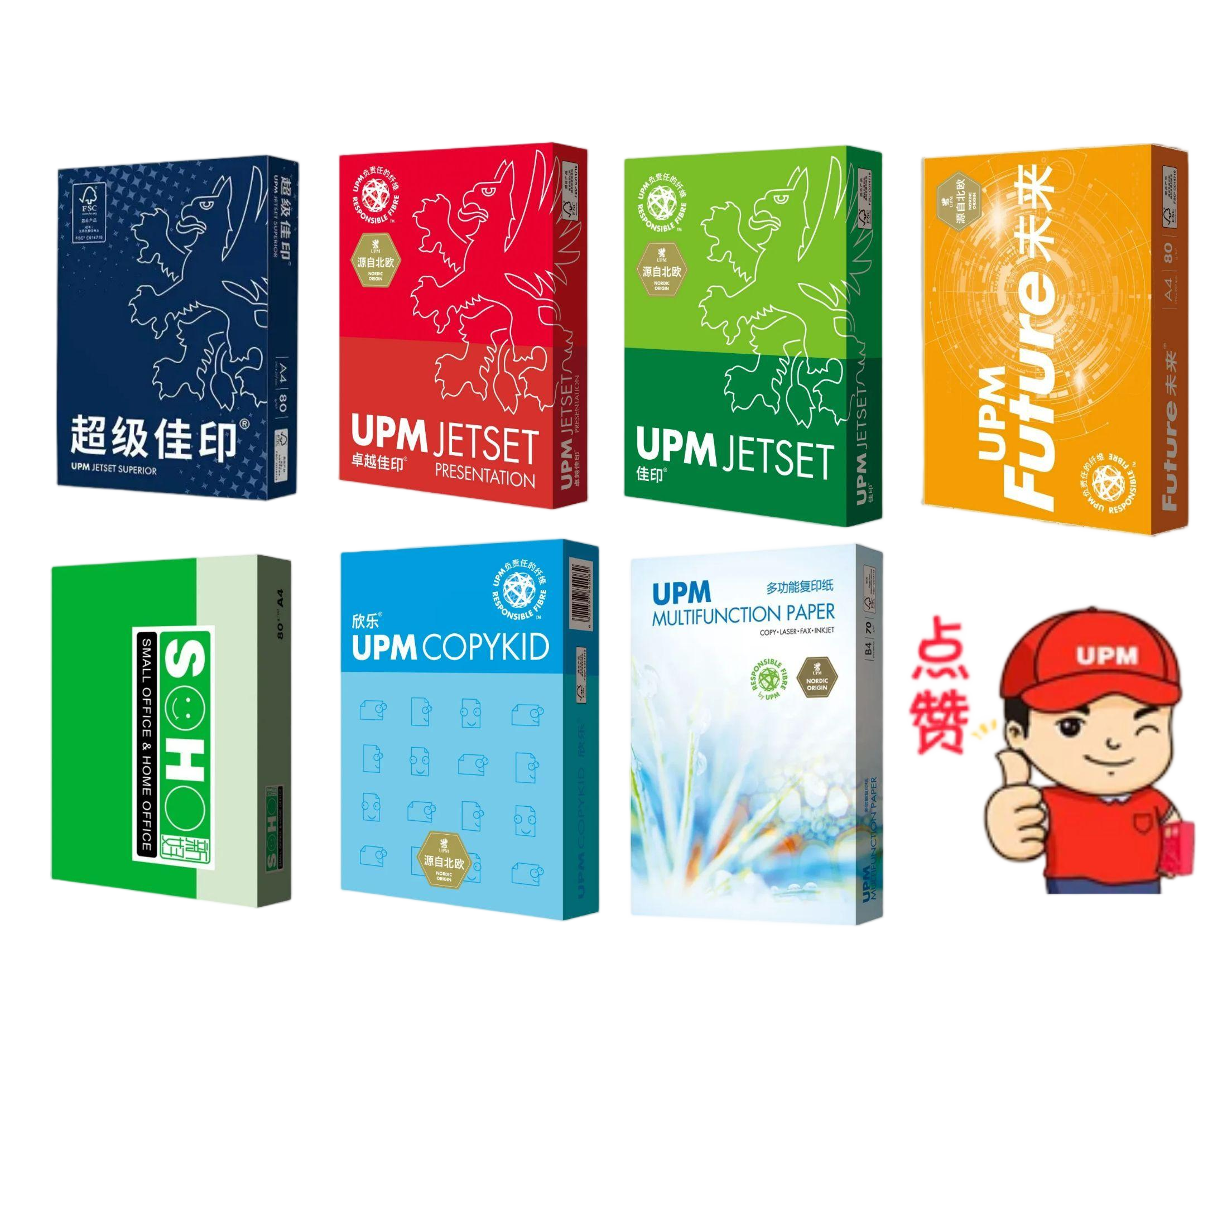

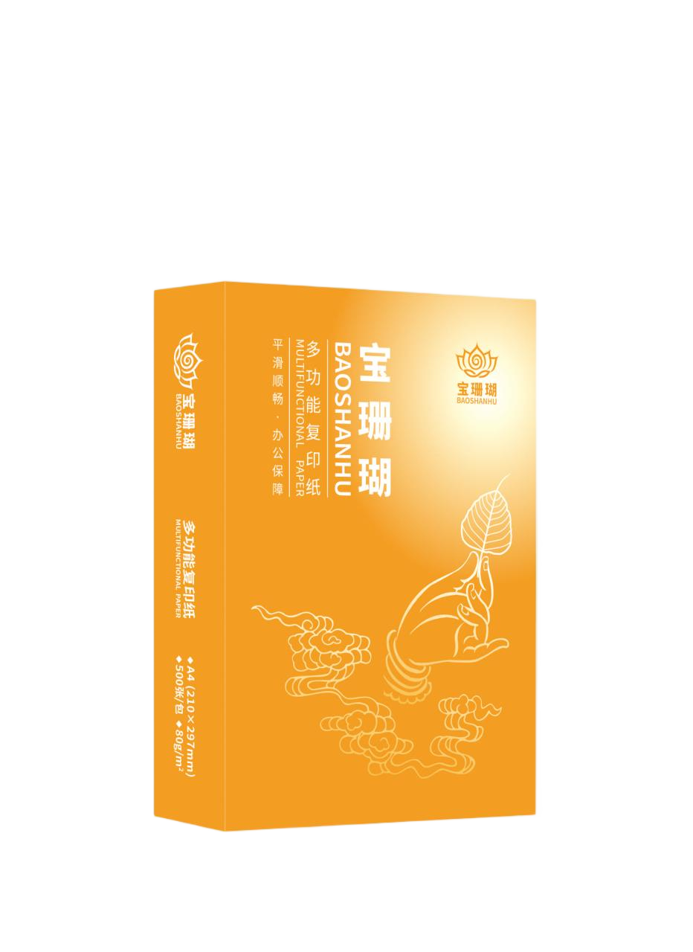
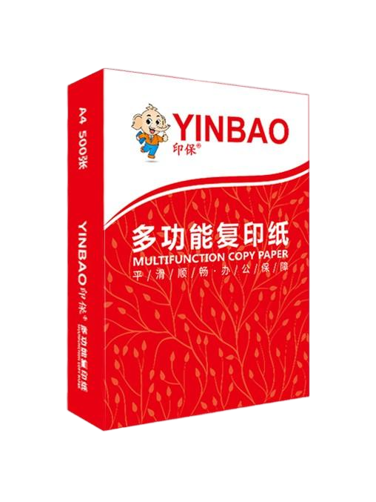
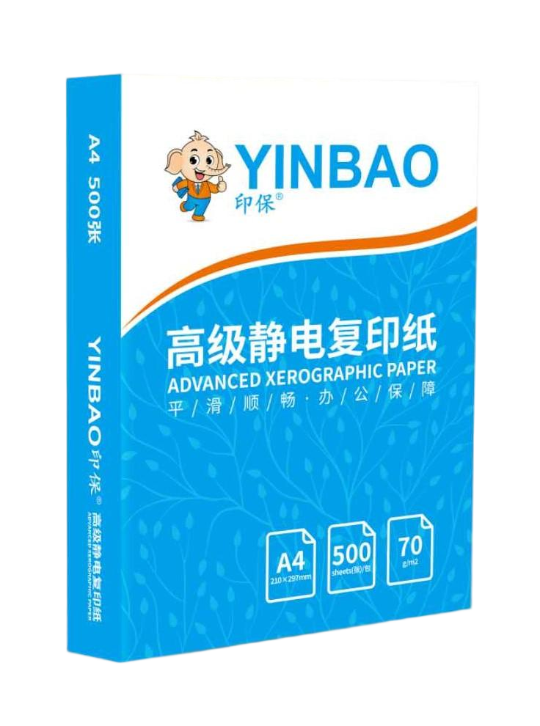
我们是UPM复印纸华南市场销售总代理，年
销售额保持在10000吨以上，同时我们也创立了自己的复印纸自切品牌“印保”、“宝珊瑚”，以优异的产品质量，赢得客户广泛好评。

Slide 6
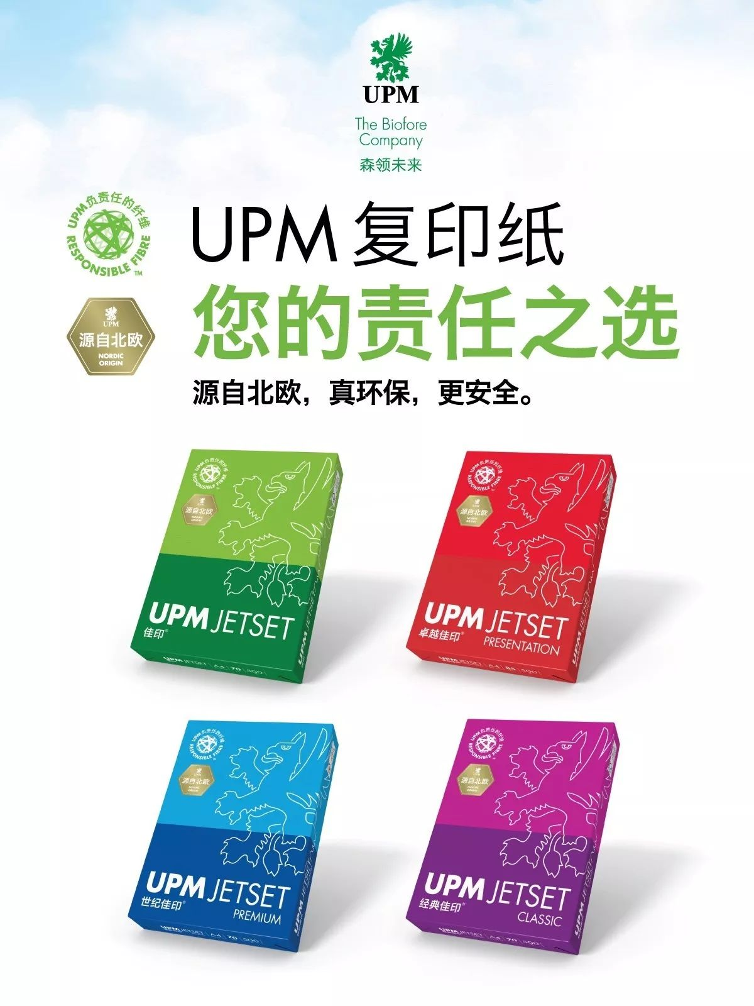
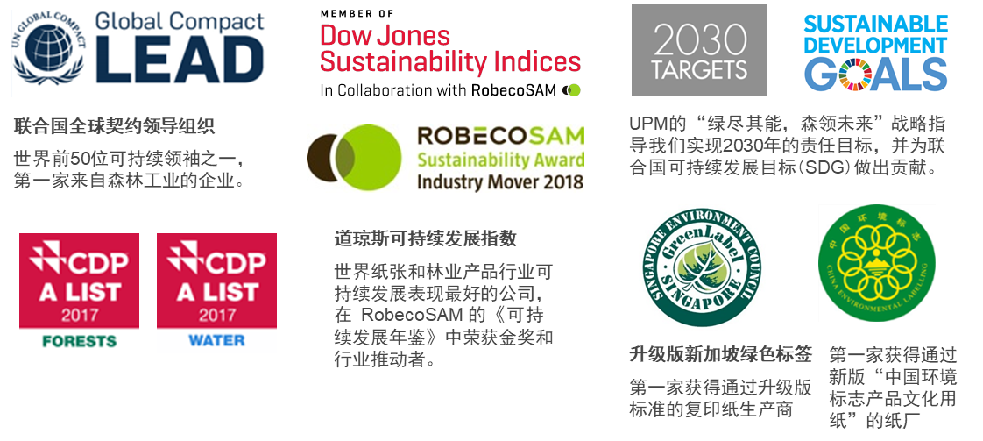
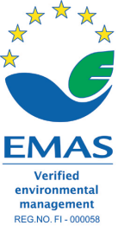

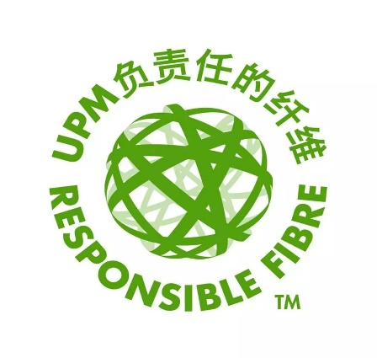

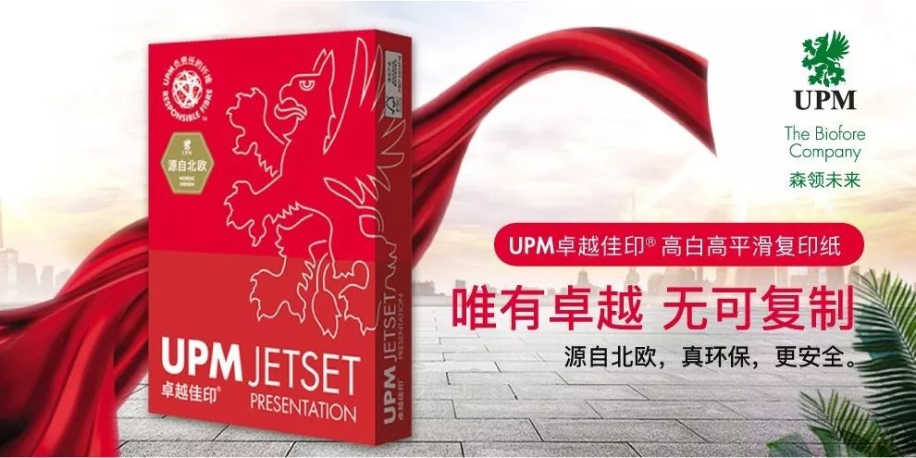
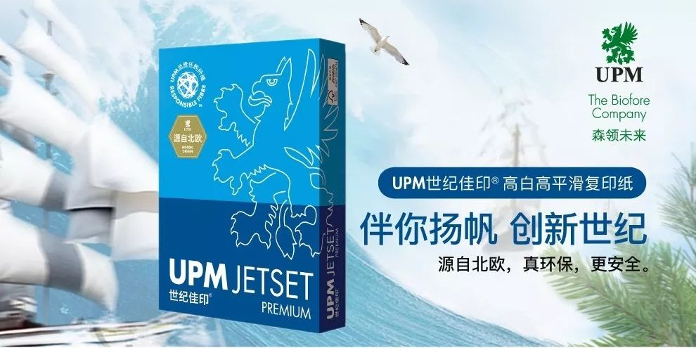
君通达核心代理产品：UPM复印纸
UPM是世界上第一张复印纸的发明者。是唯一获得欧盟环保认证的造纸企业，习主席曾亲临UPM芬兰工厂参观。UPM秉承可持续发展理念，生产出最优质、环保的复印纸。UPM 常熟纸厂环保总投资4.5亿元人民币，是亚太地区第一家获得 EMAS（欧盟生态管理与审核体系）证书的工厂，并荣获2017年首届中国“水效领跑者”殊荣，是江苏省唯一获奖业。
君通达是UPM华南地区总代理，6大系列产品满足您的各种办公文印需要。

Slide 7
附录：UPM产品的基本介绍

Slide 8
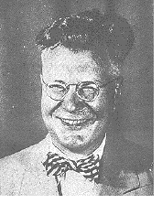
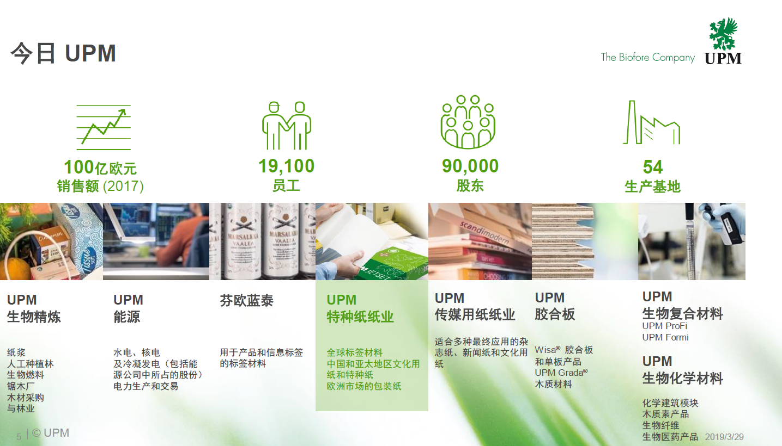

UPM是世界上第一张复印纸制造商
UPM是全球最大印刷纸生产商（1200万吨）
Chester Carlson在1938年10月22号开发出了静电成像原理
1959年首次推出了商用复印机系统
UPM66年前提供了第一批复印纸
Notes:
1959：Copier model 914→1970:Duplex copier→1973:Color Copier model6500→1990:multifunction model3010;

Slide 9
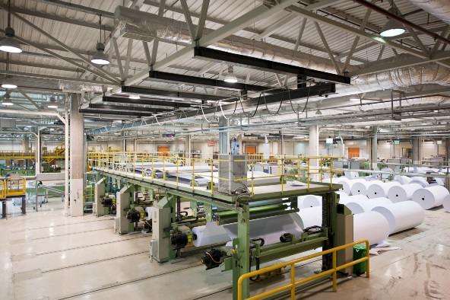
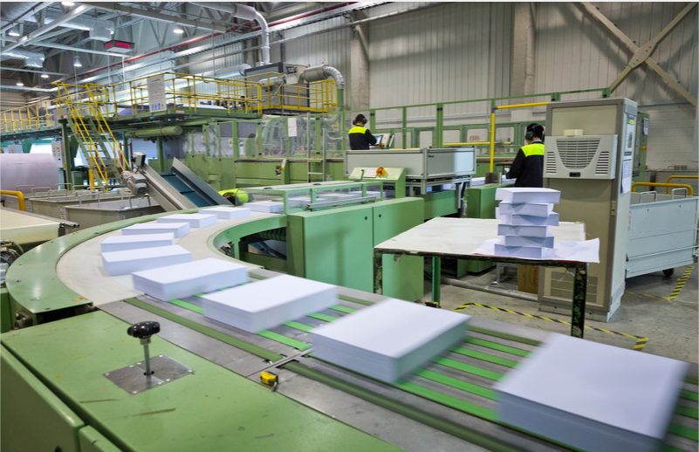
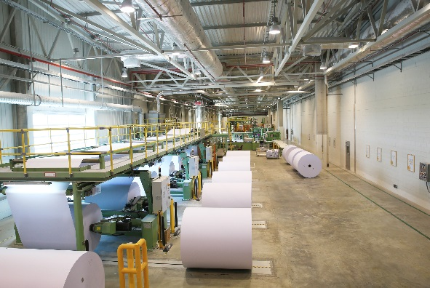
UPM常熟纸厂是中国领先的高端复印纸生产厂家
15裁A4复印纸生产线于2004年建成投产
8裁A4复印纸生产线于2012年建成投产
8裁A4复印纸生产线于2015年建成投产
复印纸加工 650,000 吨/年
平张纸加工 320,000 吨/年
10裁A4复印纸生产线于2018年12月建成投产
共有9条全自动复印纸裁切线
裁切产能：复印纸加工 65 万吨/年

Slide 10
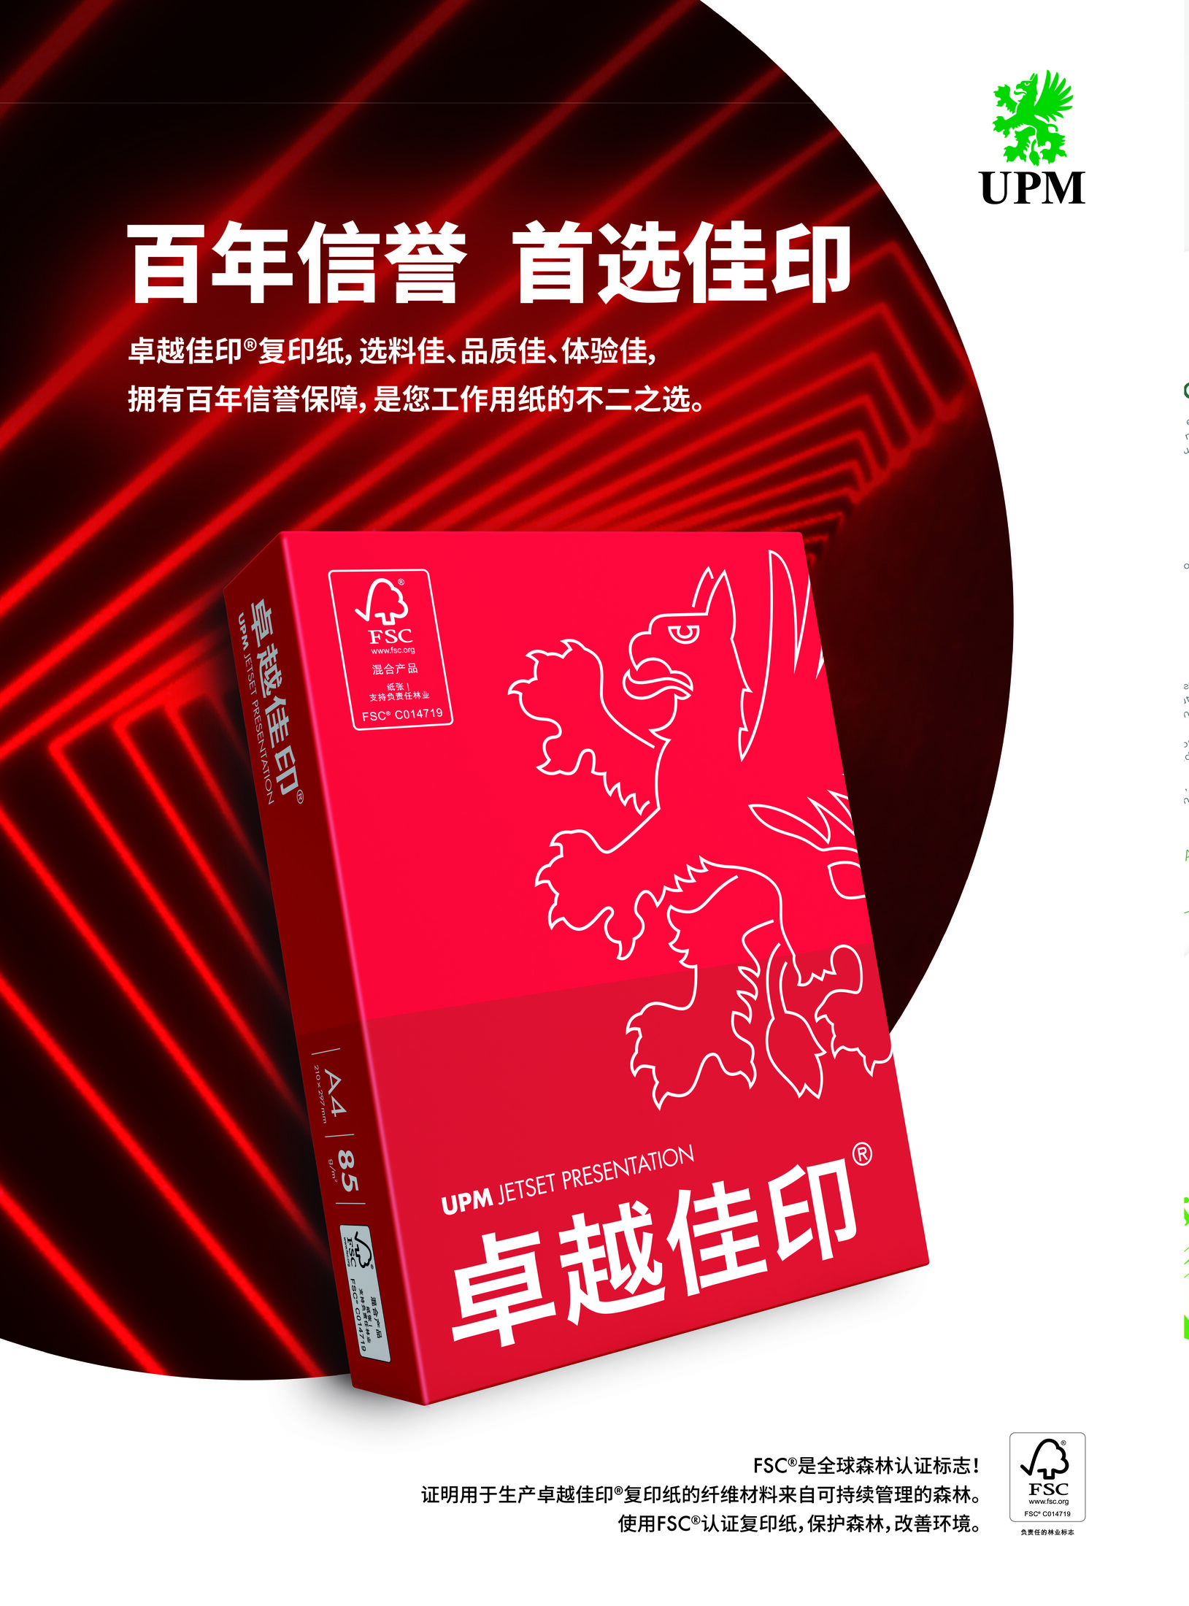
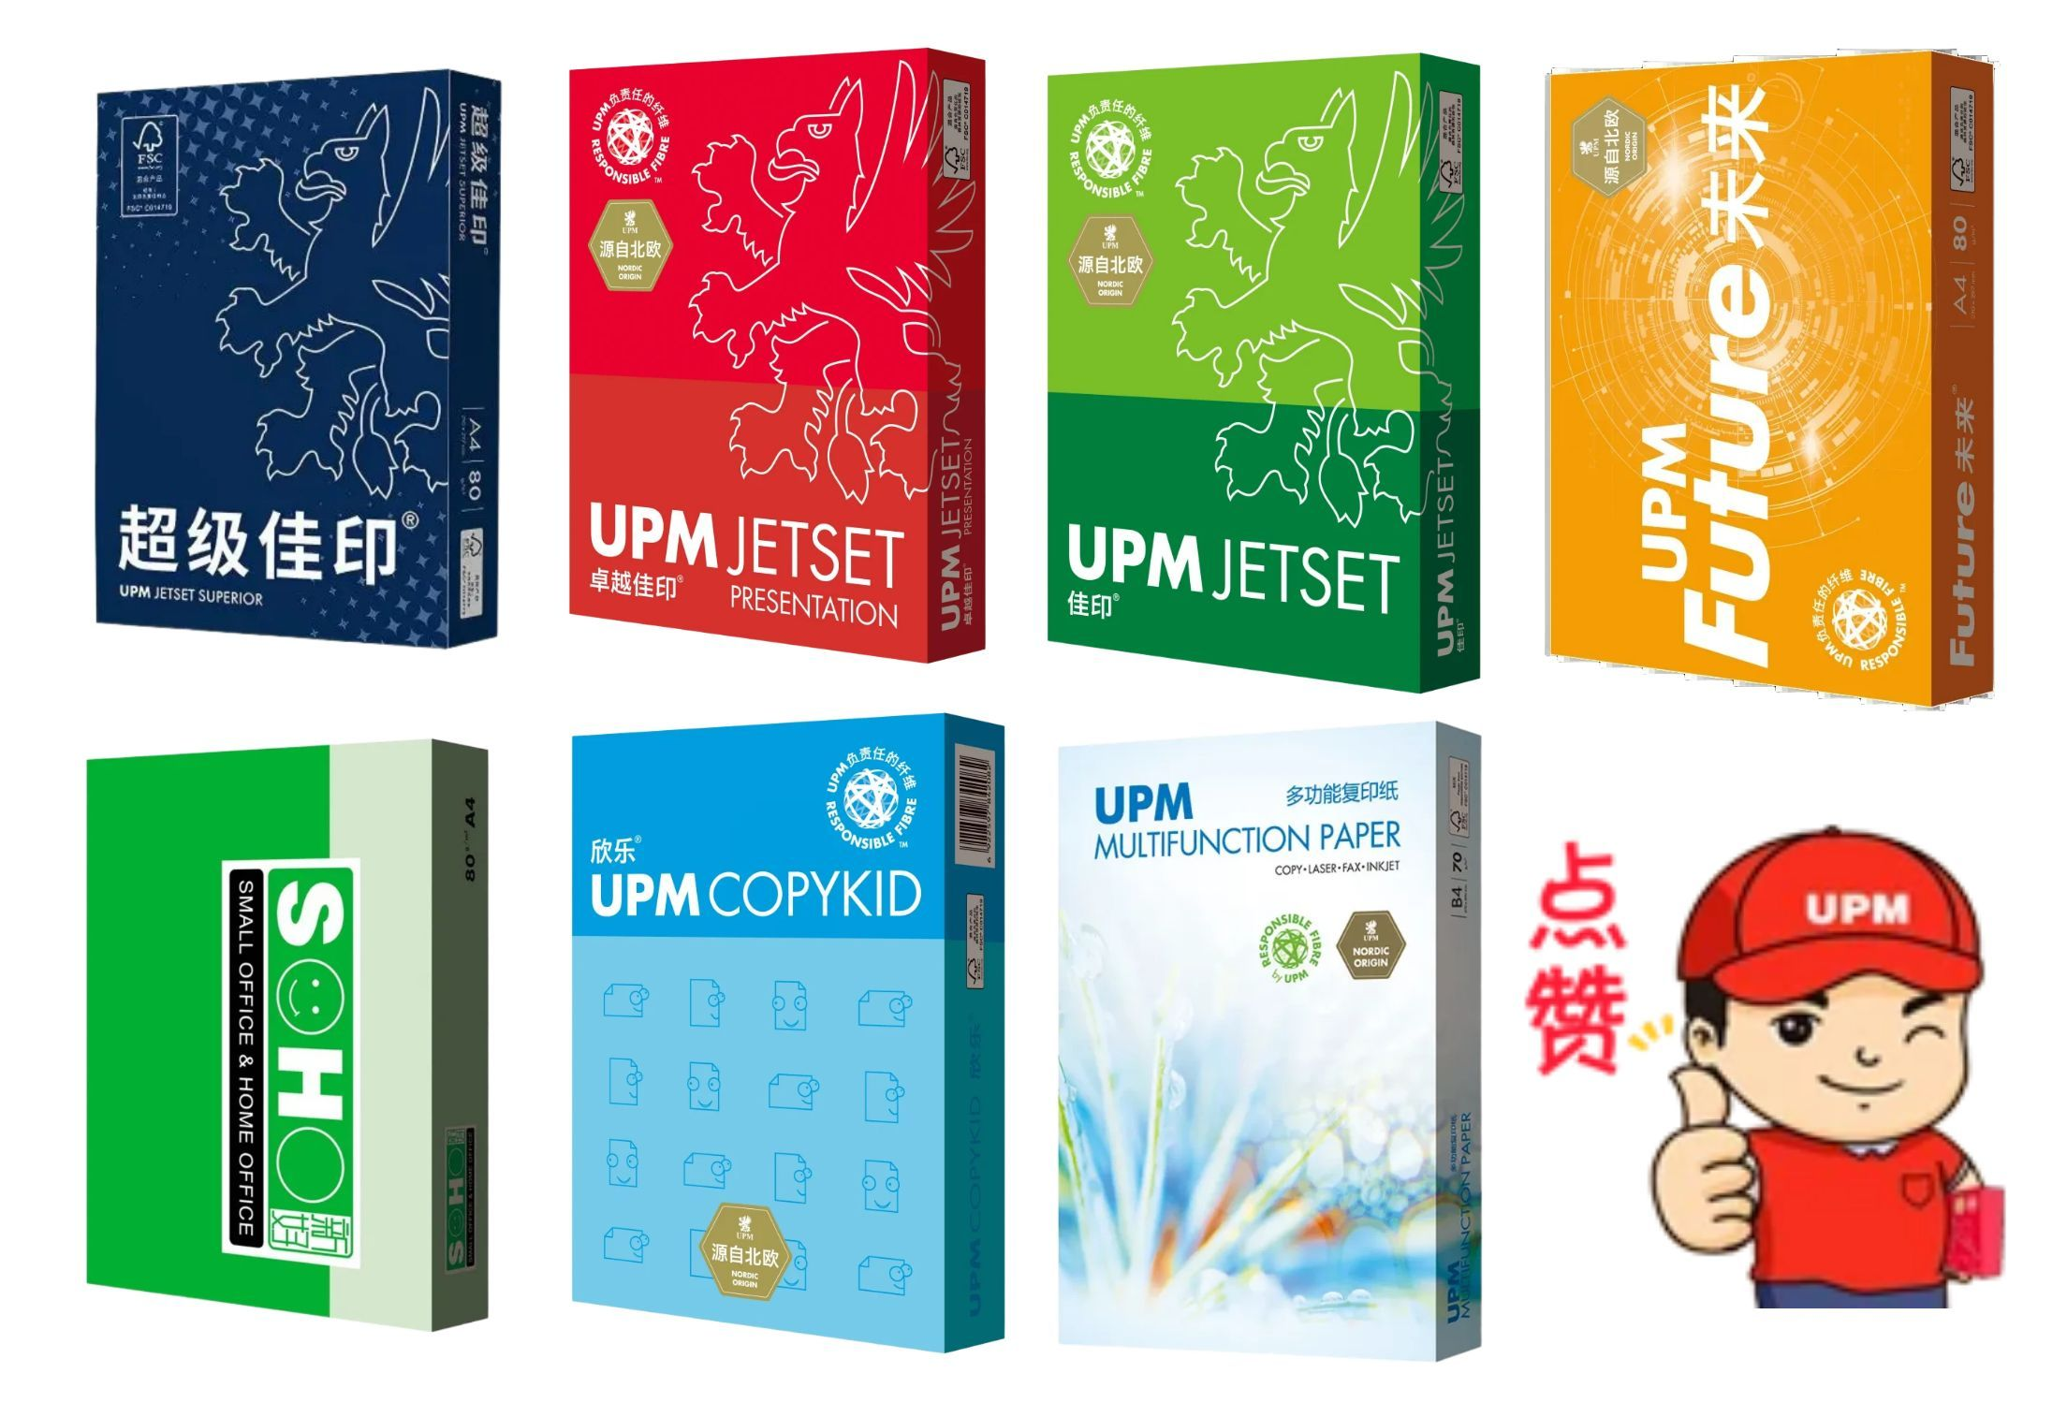
UPM产品结构丰富能全面满足不同客户群体的需求

Slide 11
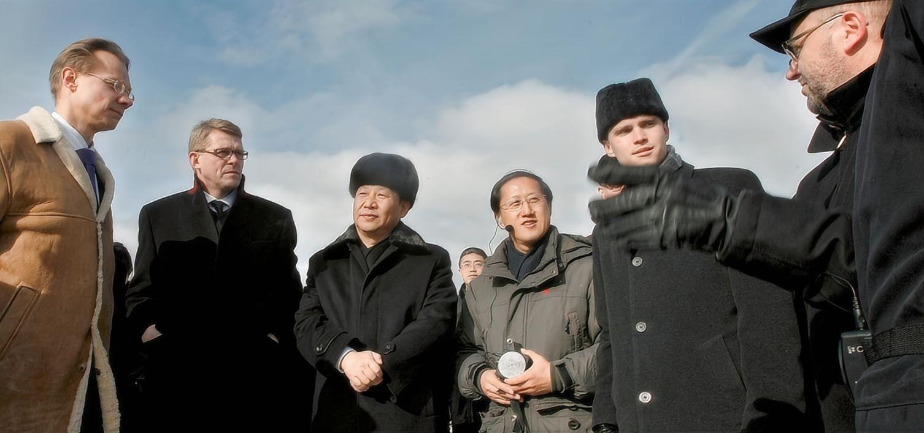
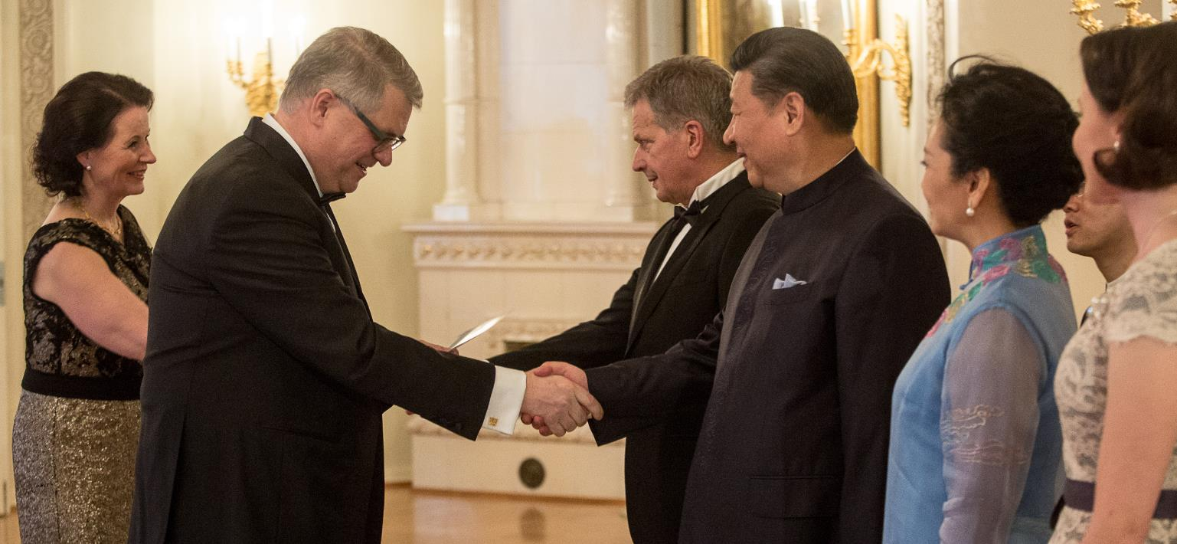
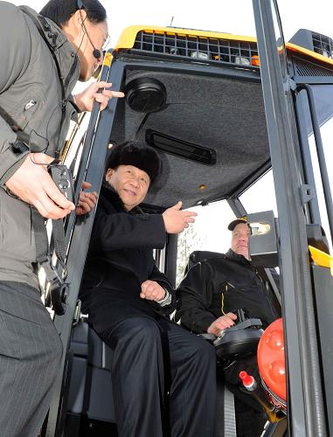
2010年，UPM接待了时任中国国家副主席的习近平，
在芬兰之行期间观看了森林采伐示范活动。
2017年在芬兰会见时任UPM集团总裁兼首席执行官贝松宁先生。
2010年3月27日，中国国家副主席习近平在芬兰罗瓦涅米芬欧汇川公司电脑伐木厂参观。这是习近平在安装有先进的GPS及电脑控制系统的森林采伐机械上了解电脑伐木的情况。
新华社记者 饶爱民摄 来源：新华网

Slide 12
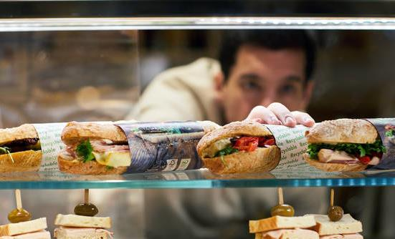
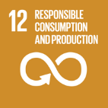
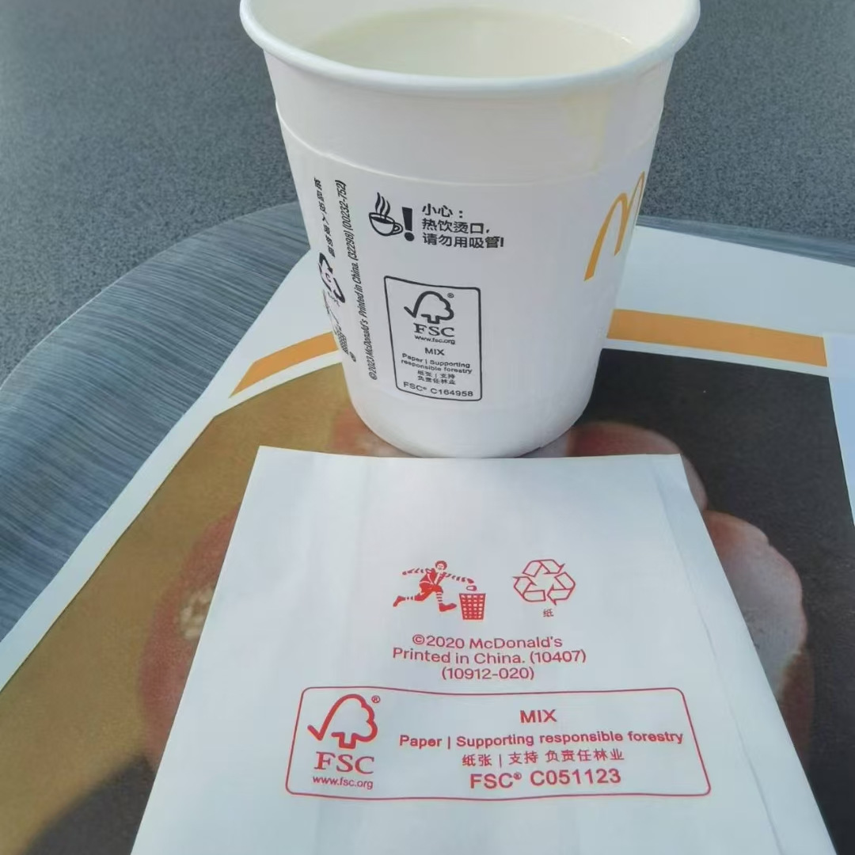
UPM复印纸是可直接与食品接触的纸张
UPM特种纸纸业的所有纸厂均已通过ISO 22000认证
中国常熟纸厂获得QS生产许可
全面执行HACCP *和GMP以确保食品安全
符合FDA食品接触和BfR食品接触
第三方测试报告和认证可验证产品安全性
产品安全配置文件提供有关产品安全的详细信息
Notes:
认证确保产品安全
ISO 9001质量管理体系和ISO 22000食品安全管理体系提供了不断提高绩效的框架。UPM特种纸纸业的所有工厂均已通过ISO 9001和ISO 22000认证。因此，我们可以提供设计和生产满足食品包装要求的几种产品。具有食品接触认证的纸张可直接与干性和非脂肪性食品接触。
危害分析关键控制点（HACCP）是识别和管理食品安全相关风险的国际公认方法，这对积极的食品安全计划至关重要，它可以为您的客户，公众和监管机构确保食品安全计划已得到实施。管理得很好。
遵守法律法规
我们遵守当地的相关法律法规，例如有关化学品注册，评估和授权（REACH）的欧洲议会与欧洲理事会法规（EC）No 1907/2006。在欧洲，我们满足所有REACH要求，并欢迎REACH作为简化欧盟化学法规的积极步骤。作为主要的化学品最终用户，我们确保所有化学品供应商都完全遵守REACH要求以及分类，标签和包装法规。
制浆造纸价值链信息系统（P＆P-VIS）
造纸制造商和化学供应商共同构建了一个基于互联网的纸浆和纸浆价值链信息系统（P＆P-VIS）平台，该系统促进了价值链中化学信息的交换，并进一步提高了纸浆产品的安全性。
基于这些声明和个人验证，我们确保我们的纸张生产符合最严格的国际法规，并确保我们的产品安全使用。
纸制品的产品安全规范
我们为纸业客户提供了一个独特的工具，称为“ UPM产品安全配置文件”，该工具可将所有相关产品安全信息的简要摘要一步一步地访问到一个简明的形式。UPM产品安全配置文件提供了有关我们纸产品安全性的详细信息，我们的管理系统以及与产品安全问题相关的证书。产品安全配置文件可用于每个纸机生产线。可以根据UPM的客户服务团队的要求以及通过UPM的证书查找器来使用这些配置文件。

Slide 13

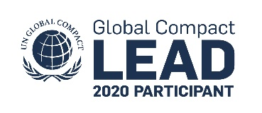


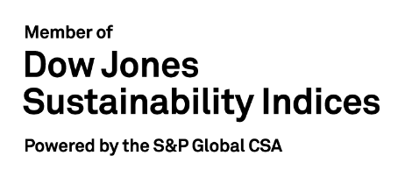

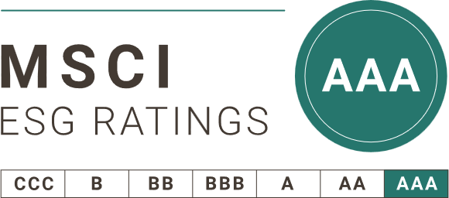

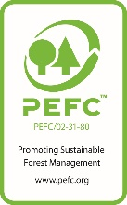


UPM是世界公认的可持续发展行业领袖
世界可持续发展领袖
负责任的供应商
联合国全球契约领导组织
世界前41位可持续领袖之一。第一家来自森林工业的企业。
全面的工厂管理系统和认可
ISO 9001
ISO 14001
ISO 22000
FSSC 22000
ISO 45001
ISO 50001
FSC/PEFC 产销监管链
道琼斯可持续发展指数
世界纸张和林产品行业可持续领袖，《可持续发展年鉴》金奖
产品获得广泛认可
在全球ESG*评级中的杰出领导地位
全球可持续发展百强榜第24位
升级版新加坡绿色标签
新版中国环境标志产品（十环认证）
Notes:
ESG (Environmental, Social and Governance) indexes help investors more effectively benchmark ESG investment performance and manage, measure and report on ESG mandates, empower investors to make climate-friendly investments
This slide shows external recognitions received by UPM. On the lefthand side are UPM’s Group level recognitions and on the right handside we have recognitions of our 3 mills (TER, JAM, NOR and CSU) as well as the eco-labels available for our papers.
More information about these recognitions are provided at: https://www.upm.com/responsibility/fundamentals/recognitions/
UN Global Compact LEAD
In September 2019 we were again recognised as a Global Compact LEAD participant for our strong engagement to the United Nations Global Compact, the world’s largest corporate sustainability initiative. UPM is among the 36 global companies to receive this recognition alongside other leading corporations, such as Danone, Nestle S.A., Novozymes ja Unilever.
We have had the LEAD participant status since 2016 and are still the only forest industry company and the only Finnish company in this distinguished network.
To be eligible for a LEAD participant, companies must join at least two Global Compact Action Platforms. We have participated to two Action Platforms: ‘Reporting on the SDGs’ and ‘Decent work in global supply chains’. Companies also need to demonstrate engagement with the initiative and commitment to defining and fostering leadership practices in line with the Global Compact Ten Principles and the Sustainable Development Goals. In addition, the companies are to report on their progress on implementing the Ten Principles on annual basis.
For more information, please check
UN Global Compact LEAD website
UPM press release 23 September 2019
Gold Class distinctions in RobecoSAM's Sustainability Yearbook 2019
In February 2019 we were listed in the RobecoSAM Sustainability Yearbook 2019, achieving the Gold Class distinction. We were one of the top-scoring companies in our industry and receive this recognition for our excellent sustainability performance. The evaluation is made by using RobecoSAM’s annual Corporate Sustainability Assessment (CSA).
Read more: RobecoSAM Sustainability Yearbook 2019
Dow Jones Sustainability Index
The Dow Jones Sustainability Index (DJSI)
lists sustainability leaders from each industry, both on a global and regional level.
The annual review of the DJSI is based on a thorough analysis of corporate economic, environmental and social performance, assessing issues such as climate change mitigation, supply chain standards, labour practices, corporate governance and risk management.
On the 16 September 2019, UPM was listed as the forest and paper industry leader in the Dow Jones European and World Sustainability Indices for 2019-2020.
Read more on our press release on 16 September 2019
Corporate Knights - 100 most sustainable corporations
In January 2020 we were ranked on the 24th place in the list of 100 most sustainable corporations by the Corporate Knights, the Canadian-based media and research company. We are the only company listed in the Paper and Forest Products category.
Corporate Knights analysed 7,395 companies with revenues more than USD 1 billion. The Global 100 Index use determined quantitative sustainability indicators, including carbon productivity (revenue-to-tonne-CO2 ratio), the percentage of taxes paid and board gender diversity, for example. 50 per cent of each company’s score[PVU1] measures the percentage of revenues earned from products and services that have environmental or well-defined social benefits.
More information about Corporate Knights and the 100 ranking
AAA on CDP's listing for Climate, Forests and Water
In February 2020 CDP recognised us as one of the only six Triple A List companies globally for our significant actions to mitigate climate risk, prevent deforestation and enhance water stewardship. We were featured on the A List for Climate, Forests and Water out of thousands who were evaluated in 2019.
By scoring businesses from A to D-, CDP evaluates organisations’ activities from being transparent; being aware of the issue; managing the issue and finally being the leader. As an international non-profit organisation CDP drives companies and governments to reduce their greenhouse gas emissions, safeguard water resources and protect forests. In 2019 over 8,400 companies with over 50 per cent of global market capitalisation disclosed environmental data through CDP.
Read more on our press release 3rd February 2020
Read more on CDP’s website.
Euronext Vigeo Europe 120 Index
UPM has been listed on the Euronext Vigeo Europe 120 Index since 2015. This index recognizes companies achieving advanced standards of excellence in Environmental, Social and Governance performance. The 330 index components are reviewed every six months in December and June.
A list of the full SRI index range can be viewed on the Euronext and Vigeo Eiris websites.
Global Compact Stock Index
UPM has been included in the United Nations Global Compact 100 since 2013. Combining corporate sustainability and baseline financial performance, this global stock index recognizes 100 companies selected for their adherence to the Global Compact’s ten principles as well as evidence of executive leadership commitment and consistent baseline profitability.
Ecovadis
Ecovadis is a ratings platform to assess corporate social responsibility and sustainable procurement.
UPM’s 99 percentile means that our score is higher than or equal to the score of 99 % of all companies assessed by EcoVadis.
CSR Ratings and Scorecards Covering 21 CSR Indicators, 190 commodities, and 150 countries – for both buyers and suppliers
Methodology is built on international CSR standards including GRI, UN Global Compact and ISO26000
Rating survey key areas
(General)
Environment
Labour & Human rights
Ethics
Sustainable procurement
No Ecovadis specific audit methods.

Slide 14

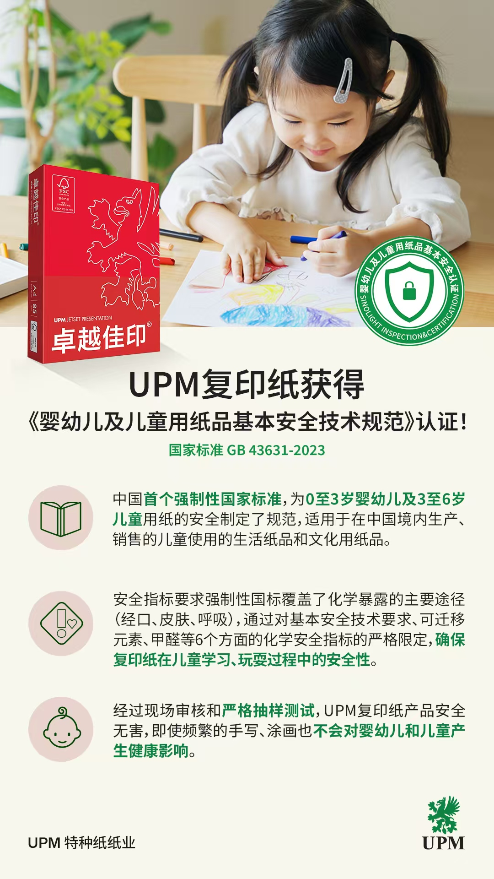
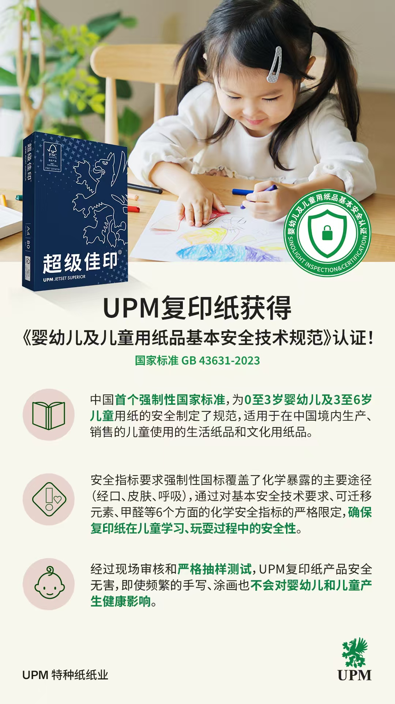
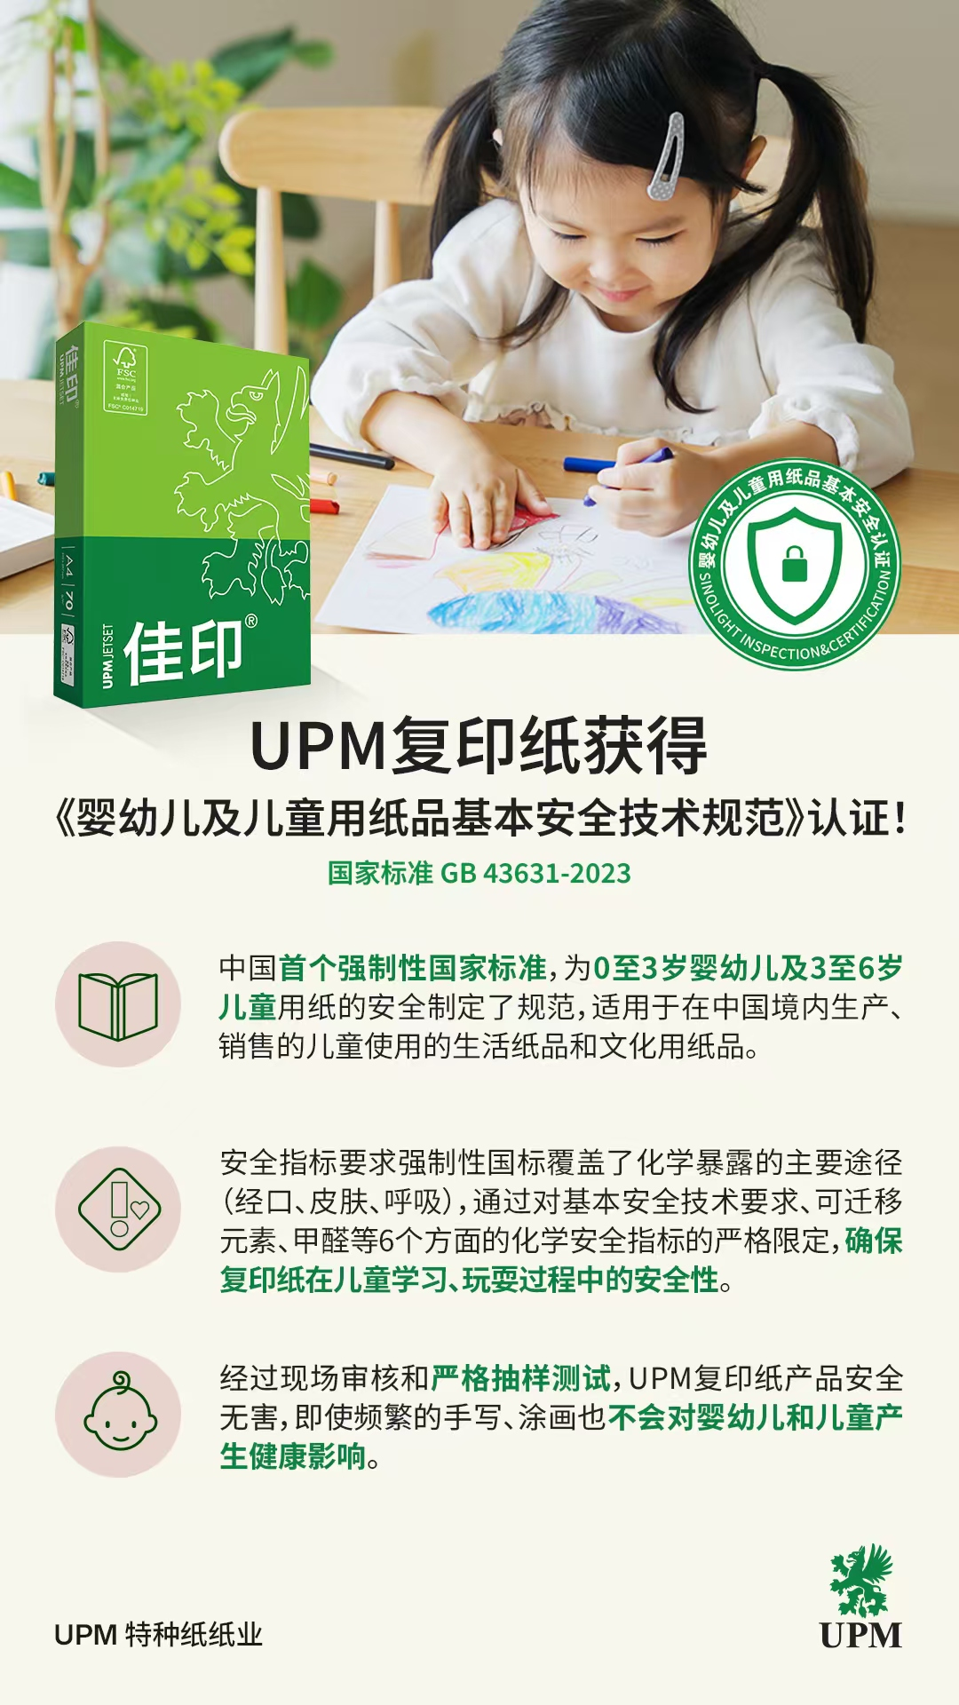
UPM首家通过《婴幼儿及儿童用纸品基本安全技术规范》的认证

Slide 15

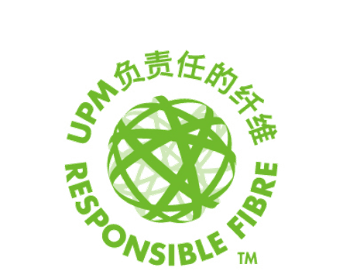
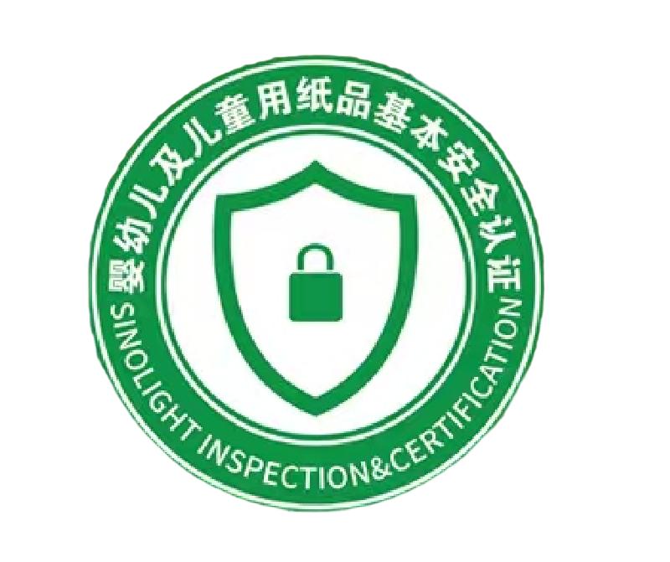
购买UPM复印纸，确保婴幼儿及儿童用纸健康！
经过现场审核和严格抽样测试，
UPM复印纸产品安全无害，即使频繁的手写、涂画也不会对婴幼儿和儿童产生健康影响。
确保了复印纸在儿童学习、玩耍过程中的安全性。

